Slide 1
Functional Dependencies and Normalization
Chapter 10
Database Design: Normalization

Slide 2
Objectives
Discuss functional dependence and primary keys
Define first normal form, second normal form, 3rd normal form, and Boyce Codd normal form
Describe the problems associated with tables (relations) that are not in first normal form, second normal form, or third normal form

Slide 3
Redundant Information and Update Anomalies
Any relation should be clear from any of
1- Redundancy:
the relation shouldn’t repeat the records
2- Update anomalies:
Insertion anomalies
Deletion anomalies
Modification anomalies

Slide 4
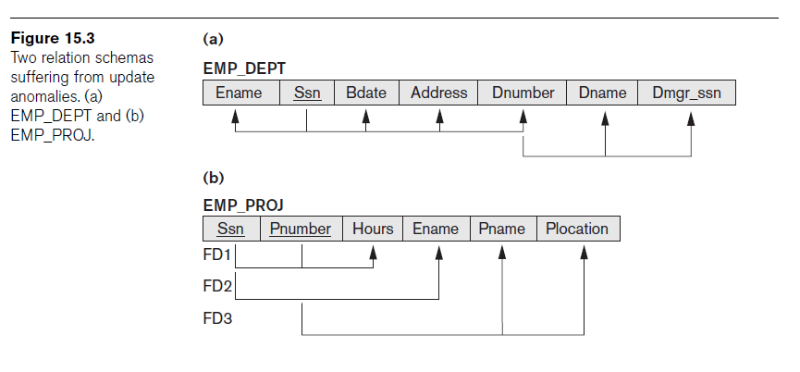
Below, 2 relation schemas suffering from update anomalies

Slide 5
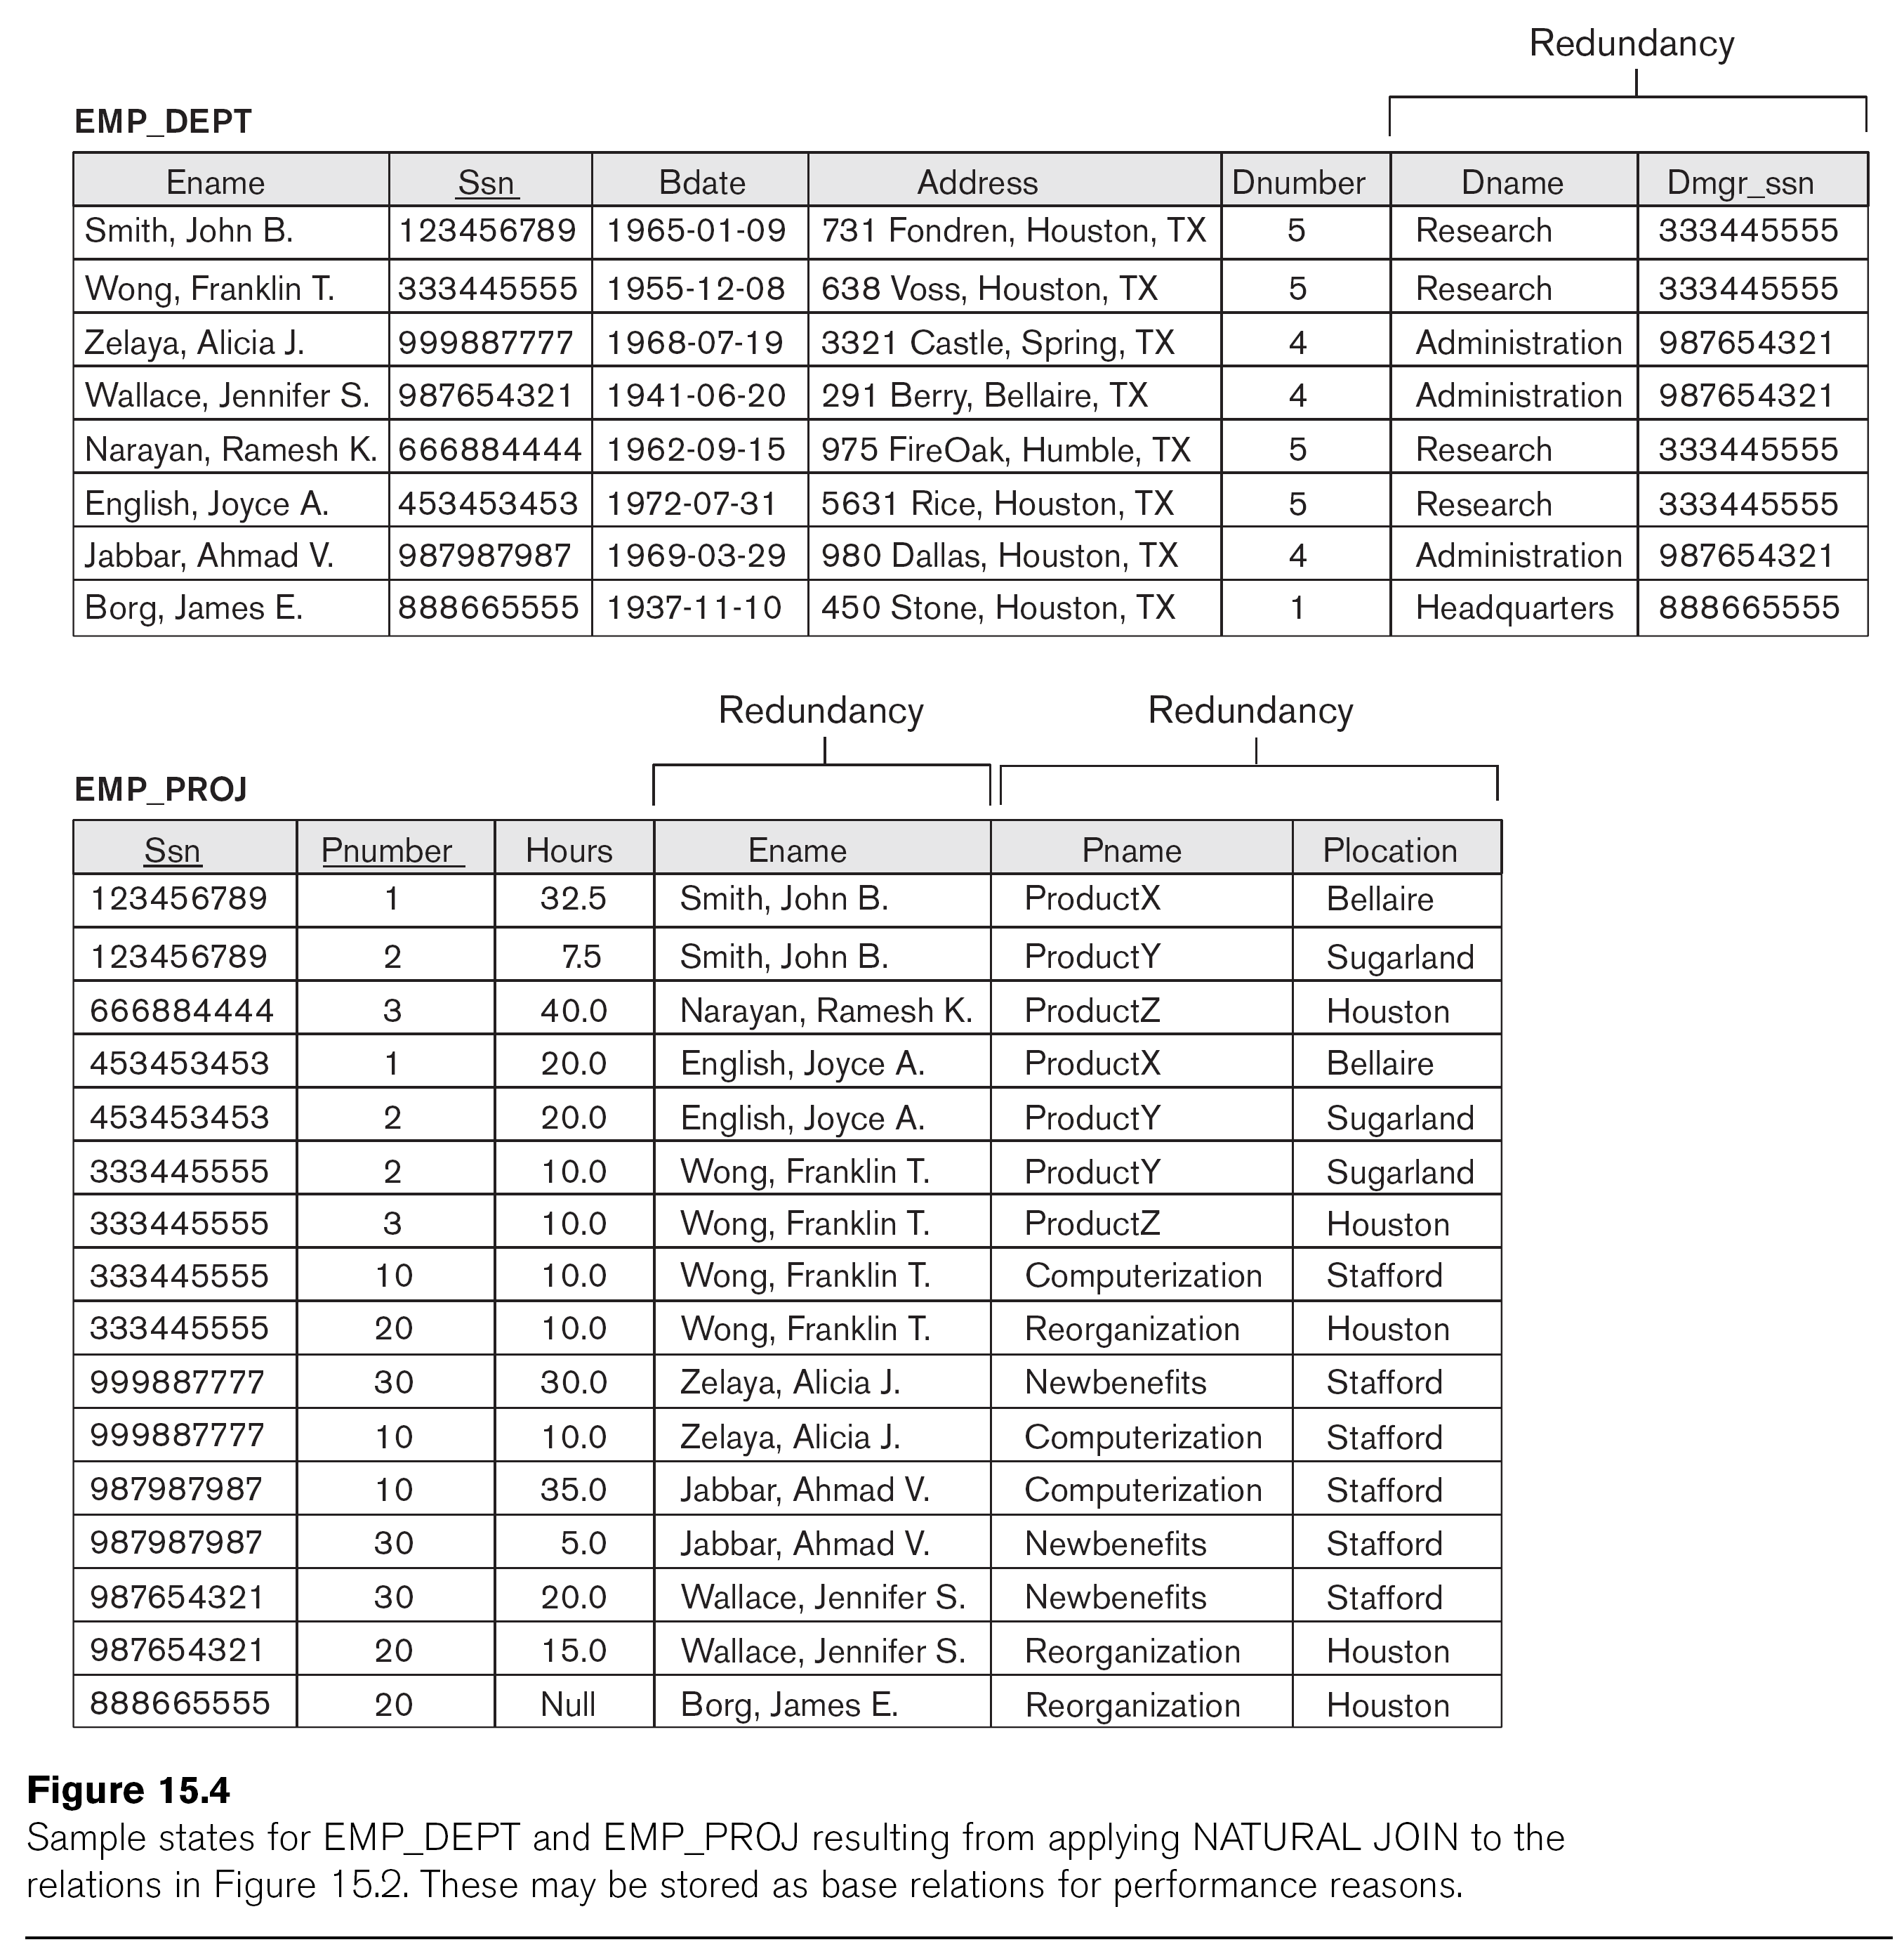

Slide 6
Update anomalies
Consider the relation:
EMP_PROJ(Emp#, Depart#, Ename, Pname, #_hours)
Note:
Changing the name of the Department from “Billing” to “Accounting” may cause this update to be made for all 100 employee working in this Department

Slide 7
Insertion Anomalies
Consider the relation:
EMP_PROJ(Emp#, Proj#, Ename, Pname, #_hours)
Note:
Cannot insert a project unless an employee is assigned to it

Slide 8
Delete anomalies
Consider the relation:
EMP_PROJ(Emp#, Proj#, Ename, Pname, #_hours)
Note:
When project is deleted, it will result in deleting all the employees who works on that project
Alternately, if an employee is the sole employee on a project and I want to delete this employee, it would result in deleting the corresponding project.

Slide 9
Normalization of Relations
Normalization:
the process of decomposing unsatisfactory “Bad” relations by breaking up their attributes into smaller relations

Slide 10
Functional Dependencies
It means the relationship between 1 attribute and another in a relation.
The normalization will take the attribute that has functional dependencies and put them together in a separate relation
X → Y
By knowing the value of X determine the Y OR
Y functionally dependent on X

Slide 11
Examples of FD constraints
Social security number determines employee name
SSN → Ename
Project number determines project name and location
Pnumber → {Pname, Plocation}
Employee SSN and Project number determines the hours per week that employee works on the project
{SSN,Pnumber} → Hours

Slide 12
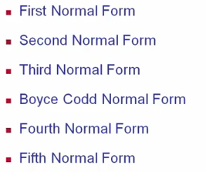
Normal forms based on Primary Keys

Slide 13
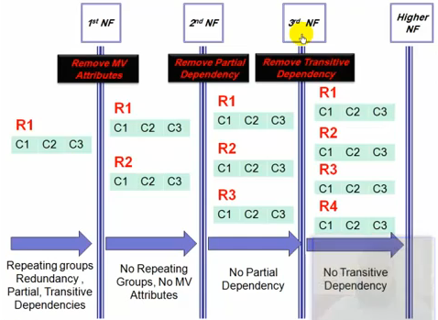



Slide 14
First normal form
Disallows:
No repeating - redundancy
Multivalued attributes

Slide 15
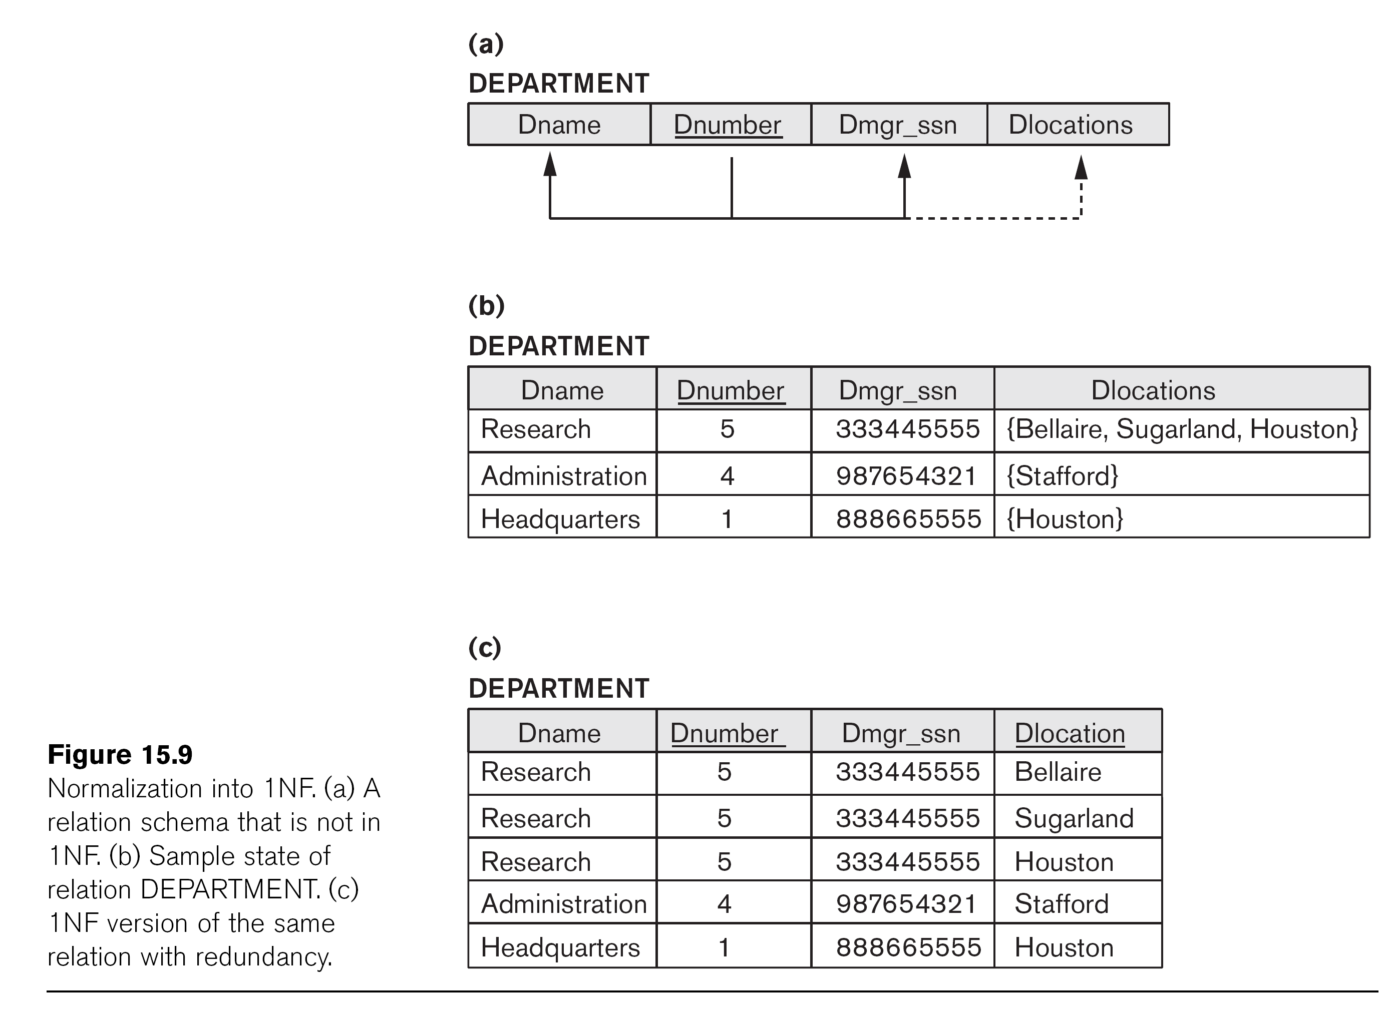

Slide 16
Department
Depart_Location
Dname | Dnumber | Dmgr_ssn
Research | 5 | 333-44-5555
Administration | 4 | 987-65-4321
Headquarter | 1 | 888-66-5555
Dnumber | Dlocation
1 | Houston
4 | Stafford
5 | Bellaire
5 | Sugarland
5 | Houston

Slide 17
Second Normal Form
To say the relation in 2nd nf, there are 2 conditions that must exists:
Cond 1: it must be in the 1st nf
Cond 2: it’s free of Partial Dependency
2NF: Every non Key column ( non prime attribute ) must depend on the entire primary key ( Prime attribute )
or Fully functionally dependent on the PK
Prime Attribute: is an attribute that is member of the PK

Slide 18
Normalization into 2NF and 3NF

Slide 19
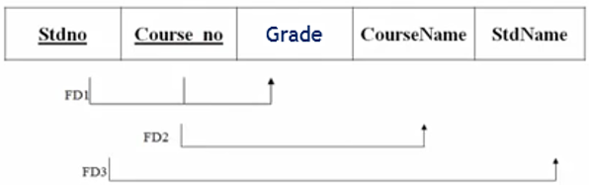


Exercise:

Slide 20
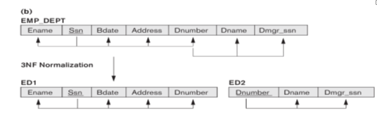
Third normal form
To say the relation in 3rdnf, there are 2 conditions that must exists:
Cond 1: it must be in the 2ndnf
Cond 2: it’s free of Transitive Dependency
Transitive Dependency means: when there’s Non Key Attribute dependent on Non Key Attribute

Slide 21
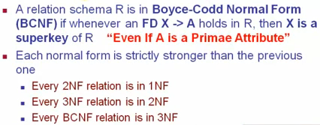

Boyce Codd Normal Form

Slide 22
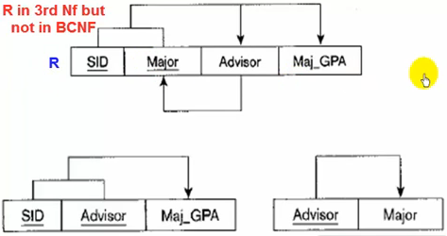

Example

Slide 23
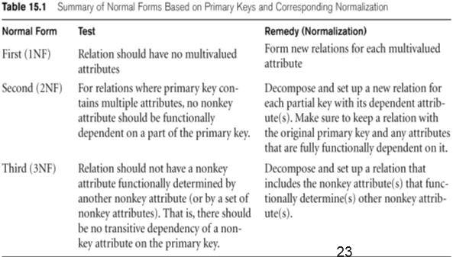
Summary of Normal Forms based on Primary Keys

